Slide 1
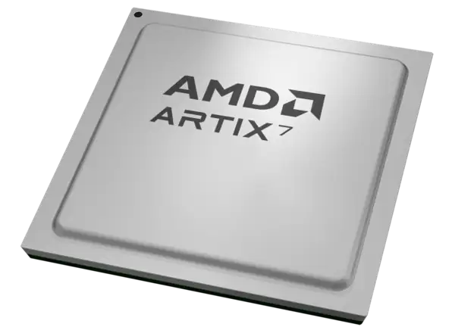
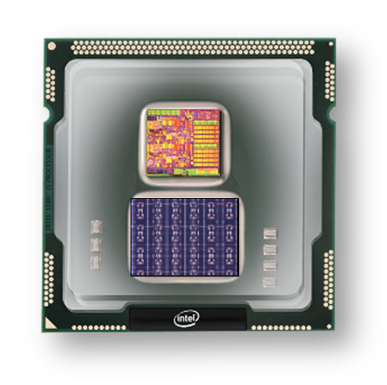
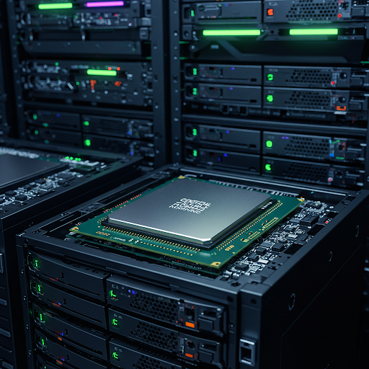
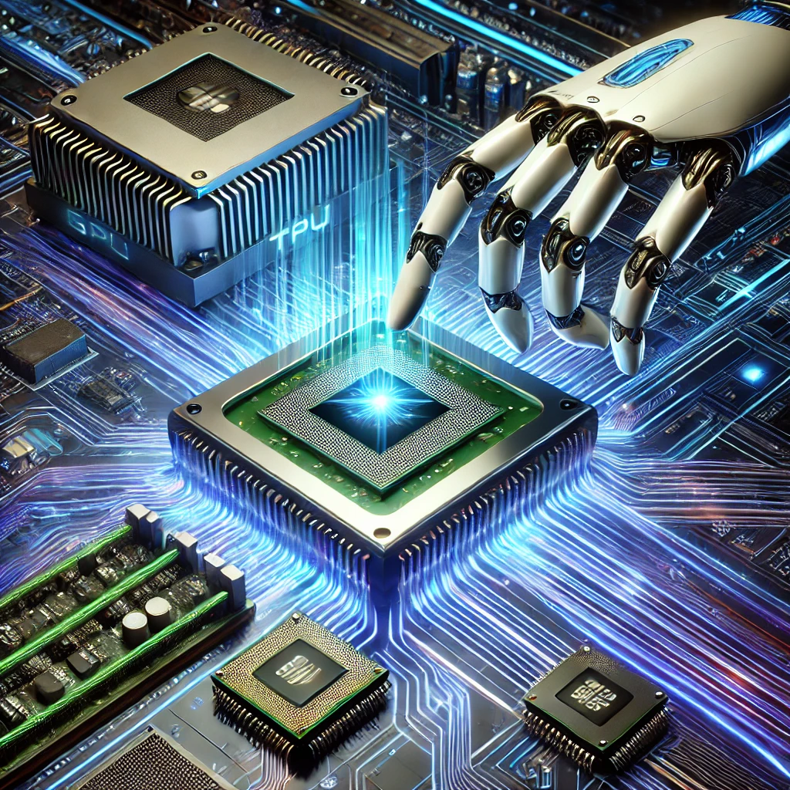
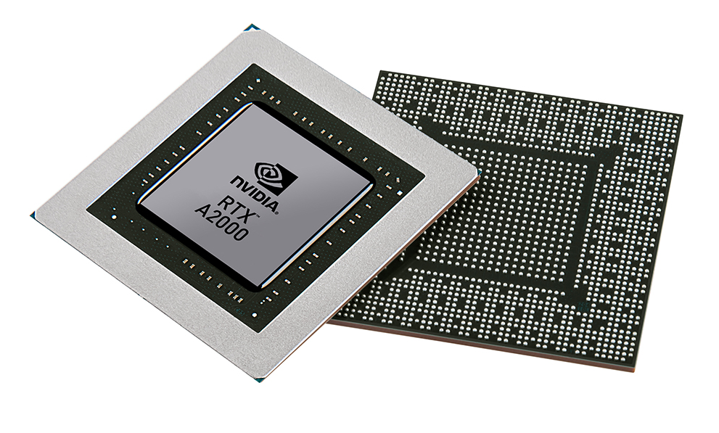


Christof Teuscher
ECE 410/510: Hardware for AI and ML
Week 10: Recap, outlook, and reminders
Portland State University
Department of Electrical and Computer Engineering (ECE)
www.teuscher-lab.com
teuscher@pdx.edu

Slide 2
What did you learn last week?

Slide 3
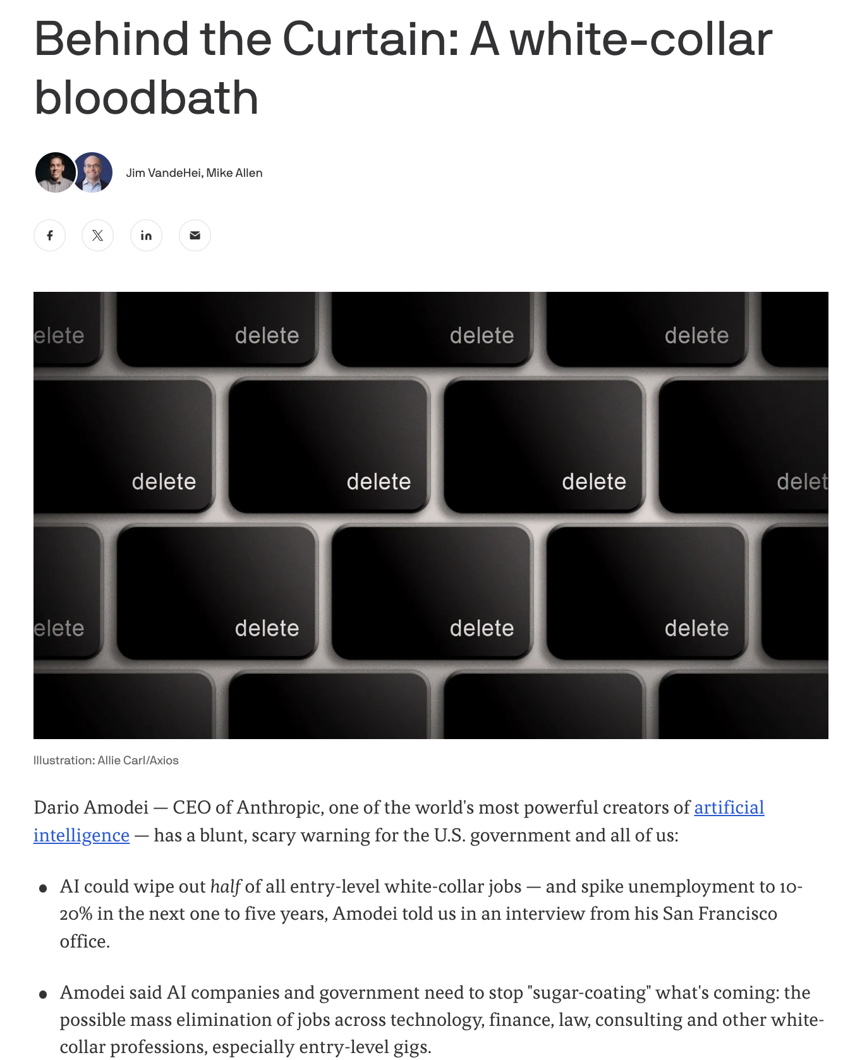
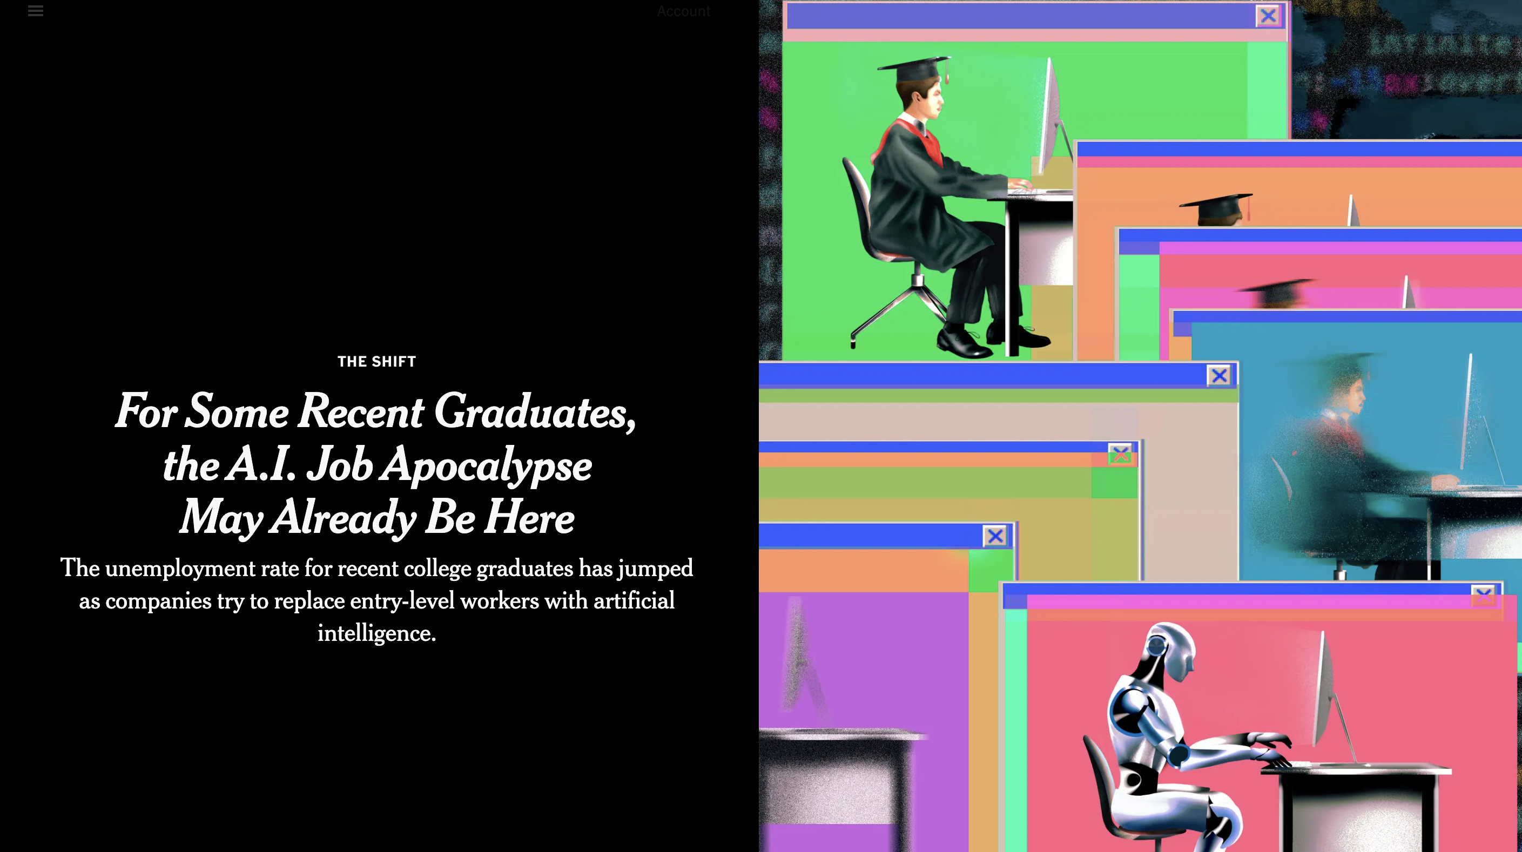
https://www.nytimes.com/2025/05/30/technology/ai-jobs-college-graduates.html
https://www.axios.com/2025/05/28/ai-jobs-white-collar-unemployment-anthropic

Slide 4
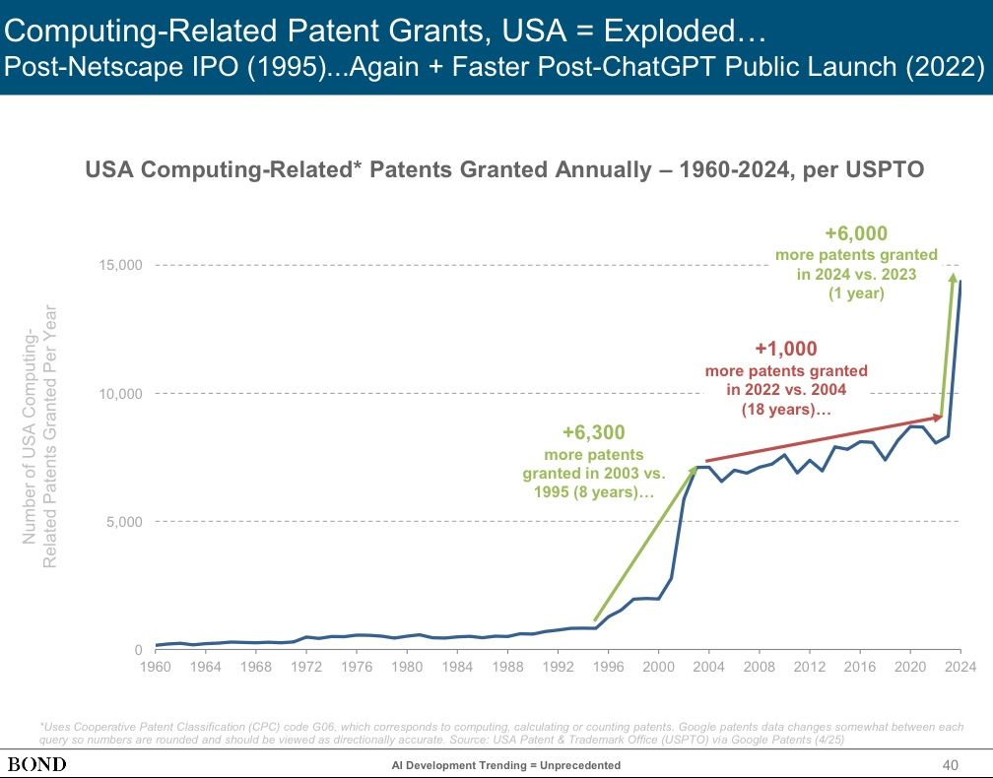
Tech acceleration because if AI
Web boom

Slide 5

https://semiengineering.com/advanced-packaging-depends-on-materials-and-co-design

Slide 6
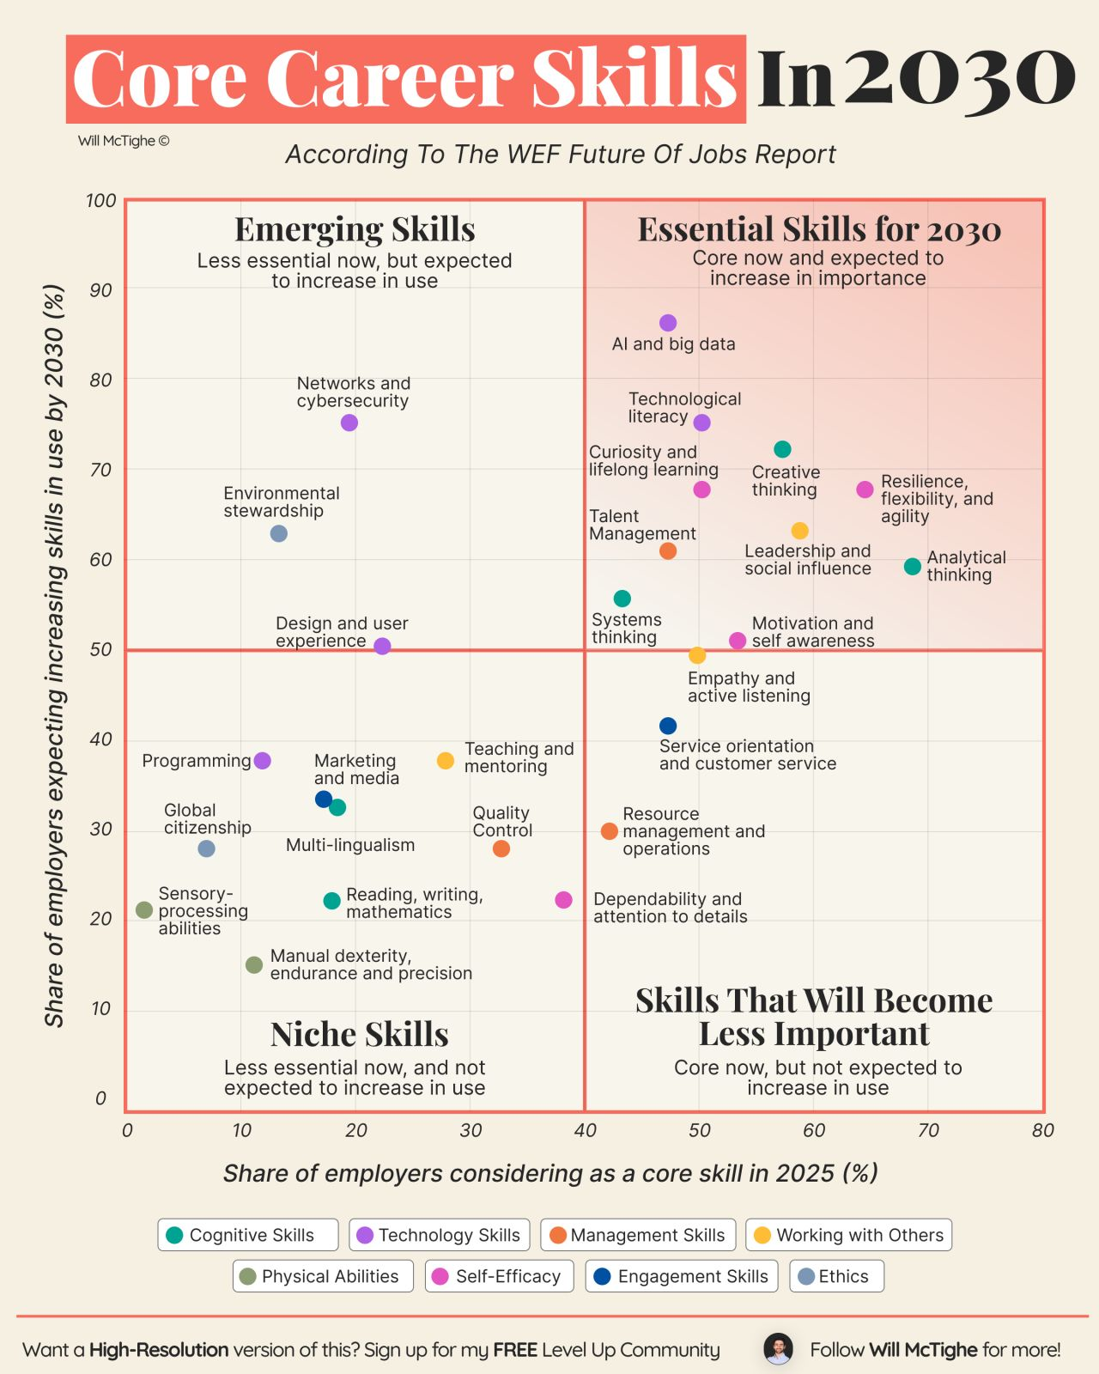

Slide 7
Week | Monday | Wednesday (Codefest)
2 | HW/AI/ML overview + codesign overview | Start main project: pick workload, start analysis, benchmark, …
3 | GPU architecture and programming for AI | Drafting a HW architecture, creating a model
4 | Deep neural networks on GPUs | Coding HW description
5 | Transformers on GPUs | First simulation + refinement
6 | In-memory computation | Improving initial design
7 | Neuromorphic chips (1): TrueNorth, Loihi, Akida | Simulation + refinement
8 | Neuromorphic chips (2) + mem devices | Synthesizing design + benchmarking
9 | Memorial Day | Final tests, validation, verification, benchmarking
10 | Emerging technologies and future directions | Doc, final tests, validation, verification, benchmarking

